Slide 1
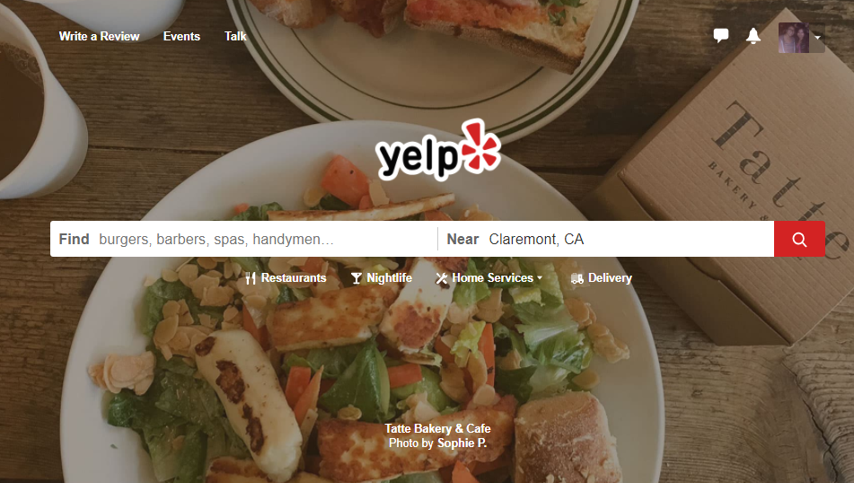
DATABASE ANALYSIS
BY:
Taehoon Kim
Jovany Funes
Melissa Nubla

Slide 2
THE YELP DATABASE
Huge Database
Monthly average of 90 million visitors via mobile app or website
148 million reviews by the end of Q4 2017
Reliable?
Notes:
SO- Why Yelp?
The group was interested in yelp because one- it’s a huge database.
It has a monthly average of 90 million visitors, and roughly 148 million reviews at the end of 2017.
THere is new data everyday, however- the group wanted to know how reliable this data could be. OUtside of the public ratings and reviews, business-provided information and user insight, we wanted to know if other extrinsic factors might affect the ratings and reviews that the establishments had received.

Slide 3
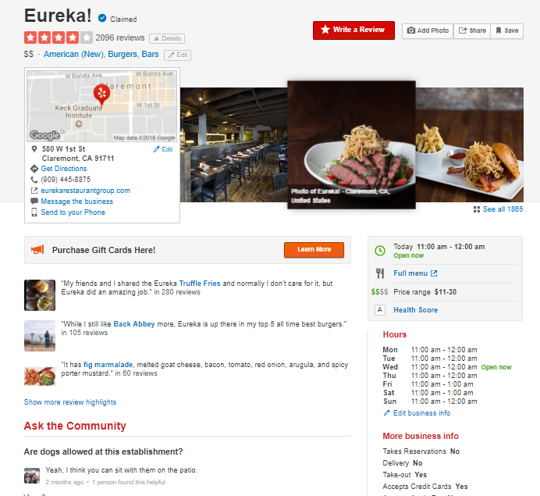
Data
ESS
Business
Name
Address
Phone number
Open hour
Menu
Price range
Others
Notes:
What do we mean by “reliable”?
Well, through yelp we are able to find information about the business.
Every business owners are able to display information that they think people might want to look at.
And as you can see on this picture, they’ve got name, address, phone number, open hour, menu, and price range and others like the menu and images of their products, which are often uploaded by users-
It is basically promising to use yelp because it’s almost like free marketing for the business (at least if the reviews are good)
The business information is provided by the businesses themselves, and so we know that this could more or less be reliable data, except for the occasional abandoned pages that haven’t been updated forever.

Slide 4
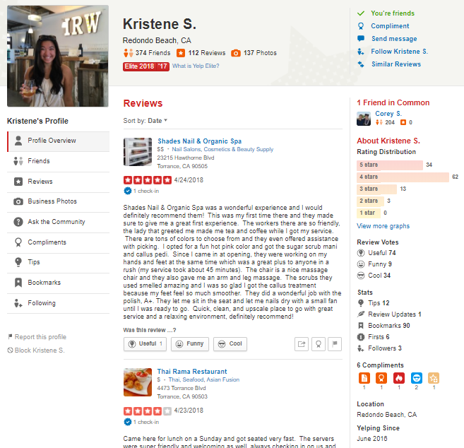
Data
Users
Find location
List of businesses in the area
See other people’s comments
Average Score
Order Delivery & Takeout
Make reservation
Notes:
The Users, on the other hand, are able to do two things.
First, they are able to find information about the businesses that interest them.
This could be anything from location, ratings, and even search for specific cuisines or specialty services.
Users are even able to see what businesses are close by and the exact proximity to them
Second, they are able to rate and review the businesses and even sometimes avail of free yelp “check0in” goodies
If you are an “Elite” member like my friend over here, you get some extra perks like being able to attend free yelp “events” and receive freebies every once in a while.
THe point that we are getting to with this is that while the information we get is substantial and valuable, we must always remeber that this comes down to subjective opinions of yelp users.

Slide 5

Our Questions
Yelp provides great information
Usually relatively accurate
Subjective
Intrinsic factors usually controls average rating
Quality of Food and Service
Ambiance
Health Score Ratings
That’s it??????
Notes:
We’ve established that yelp is a great database that can provide a lot of valuable market and consumer information if manipulated in the right way.
One problem that we found, was that a lot of yelp information is affected by intrinsic factors like the quality of food, serving attitude, and sanitary conditions.
The group wanted to find out if there were other factors that could play into these ratings.
We decided that we wanted to focus on looking at possible extrinsic factors that might affect the number of stars a business receives.

Slide 6
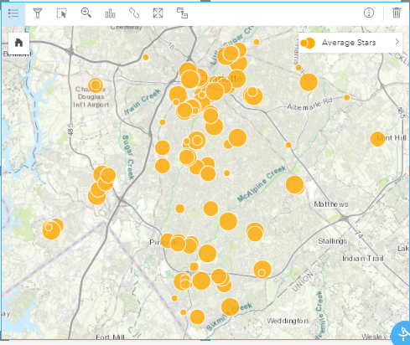
Goal: Find other variables
Consider Extrinsic Factors:
Location?
General Income?
Overestimation?
Underestimation?
Notes:
We decided that we wanted to focus on looking at possible extrinsic factors that might affect the number of stars a business receives.
WHat we want to do is find other variables that might affect the yelp reviews.
We did this by coming up with Questions like if there is a relationship between the area in which a business is located and the number of stars it had and if these external factors might cause some skewing in the data.
For example, let’s say that people in one location have higher income, so they traveled a lot and experienced many high-quality foods. They may be very strict about giving stars. Therefore, it could happen that 3 stars’ restaurants in one location is equivalent to 4 stars’ in another
Basically other external factors that might cause an overestimation or underestimation of rating for the establishment
We thought that extrinsic factors of the restaurants other than intrinsic factors such as quality of food, serving attitude, and sanitary condition could affect to either overestimate or underestimate the restaurants by giving them more or less stars.
For example, let’s say that people in one location have higher income, so they traveled a lot and experienced many high-quality foods. They may be very strict about giving stars. Therefore, it could happen that 3 stars’ restaurants in one location is equivalent to 4 stars’ in another.

Slide 7
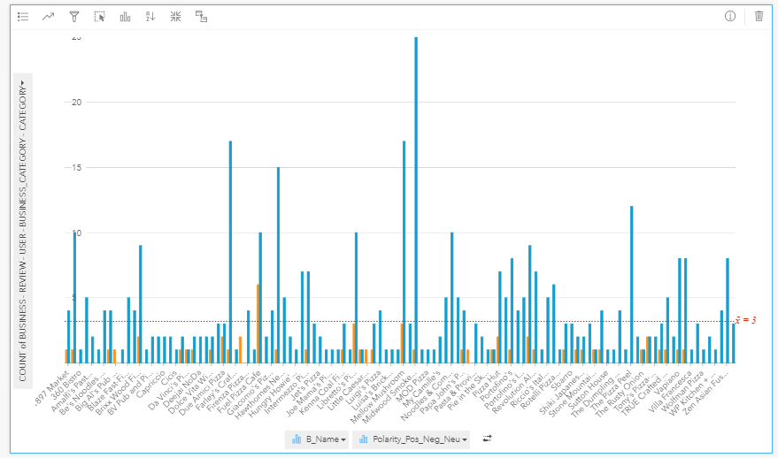
Expected Results
Notes:
Check for polarity of reviews

Slide 8
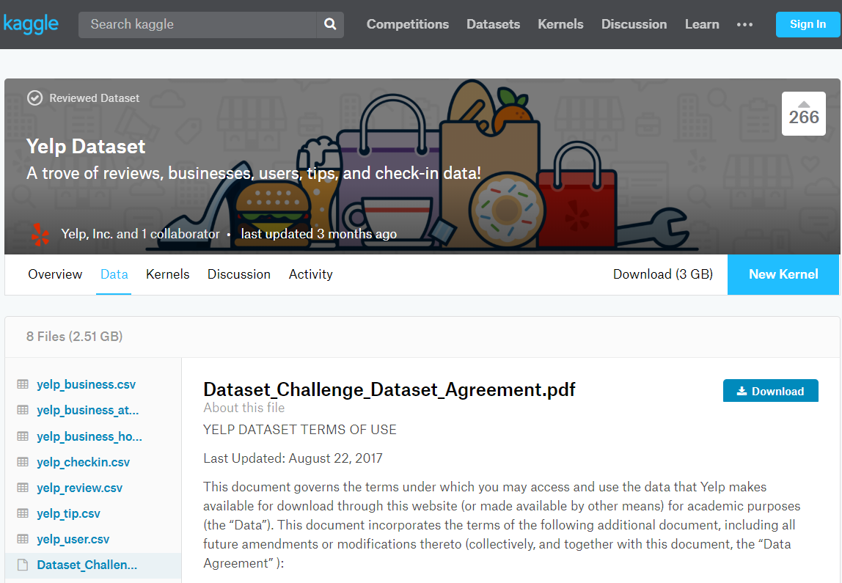
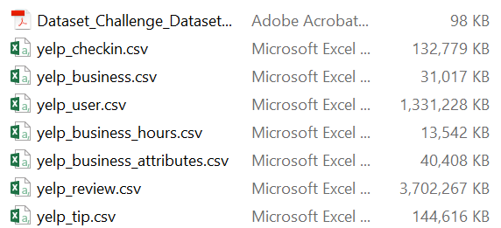
Data Source
Kaggle
(https://www.kaggle.com/yelp-dataset/
yelp-dataset/data)
7 CSV Files
Notes:
In the proposal presentation, we said that we got the dataset from yelp website. However, the data were too big to handle.
Some of them were not even opened properly.
Then we again obtained another one from Kaggle that you see here.
One zipped file had 7 csv files and the largest one was about 4 gigabyte, which contains around a million rows.
The size was still big, but luckily, we were able to use them this time.

Slide 9






Data tools and languages
Notes:
There are six tools that we have used to preprocess, normalize, and demo data.
They are python, SQL, ACCESS, Excel, Insights, and Caspio.
We will show you where we used them later in the presentation.
Now I will hand you over to Taehoon to talk further about our process

Slide 10
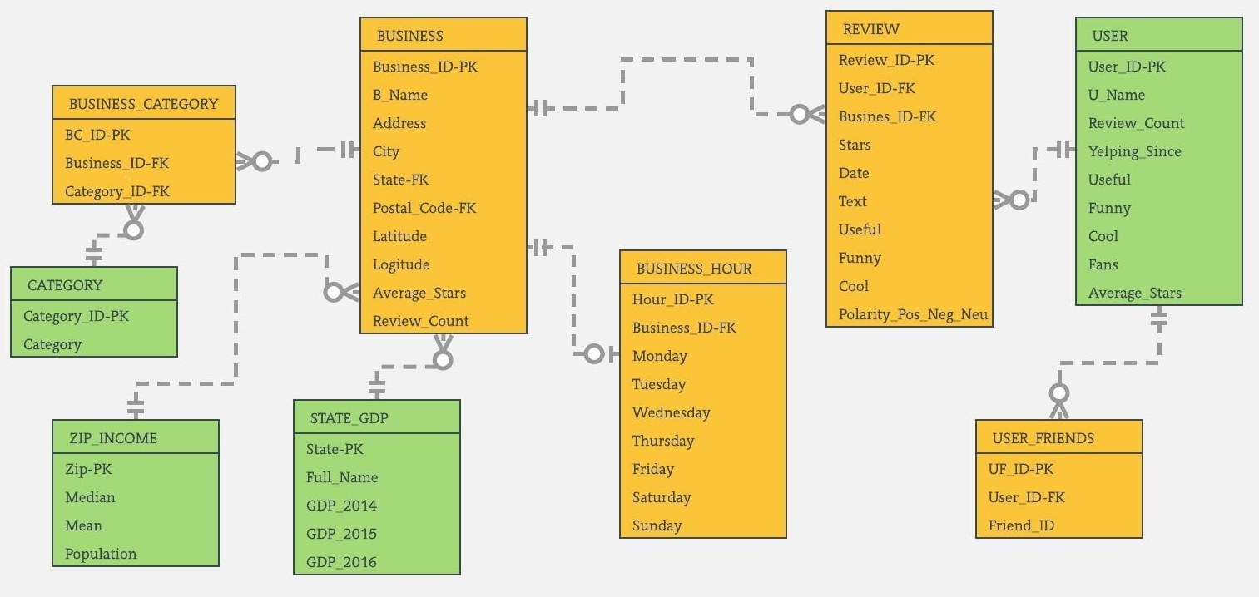
ER-Diagram
Notes:
This is the ER-Diagram we created. We have 9 tables here.
In the beginning, we had 7 tables, but we added later
two more tables and a polarity attribute in REVIEW table that are in a red box.

Slide 11
Preprocessing Data
Selected four csv files from datasets:
Business, Business_hours, Review, User
Deleted unnecessary rows and columns
BUSINESS
Not in the United States
Not related to restaurant
States that do not have restaurants more than 100
Rows that have null value in attribute, Business_ID
REVIEW, USER, and BUSINESS_HOUR
Not related to BUSINESS
Notes:
From the Kaggle dataset, we used 4 csv files, BUSINESS, BUSINESS_HOUR, REVIEW, and USER. Which means we started with 4 tables. Then we added and subtracted data from there.
As I mentioned, each of them had a huge amount. And some of them were not necessary.
Using SQL, we started to delete the unnecessary rows and columns.
We wanted to look at only the restaurant business that are located in USA, so deleted all the others.
Also, we deleted rows in BUSINESS table that has null value for Business_ID because it is the primary key
And the key is not supposed to have null value.

Slide 12
Example of Deletion using SQL
DELETE *
FROM BUSINESS
WHERE categories NOT LIKE "*Restaurants*";
DELETE *
FROM USER
WHERE User_ID NOT IN
(SELECT U.User_ID
FROM REVIEW AS R, BUSINESS AS B, USER AS U
WHERE R.Business_ID = B.Business_ID and R.User_ID = U.User_ID);
Notes:
These are the example of deletion
First one delete every business that is not related to restaurants
Second one deletes every rows in USER table when user has not left a review for any of businesses in BUSINESS table.

Slide 13
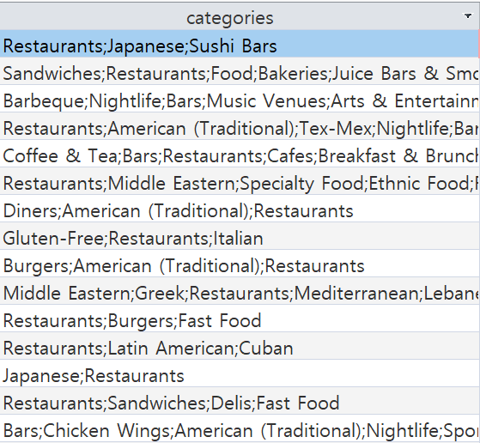
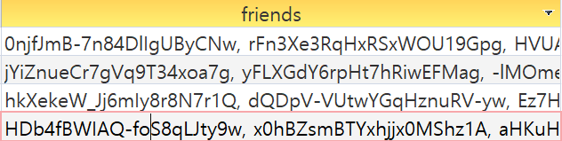
Normalization Process
Found Violation of 1NF in BUSINESS and USER table
More than 1 element in one cell
Multivalued dependency with primary key of each table
Business_ID Categories
User_ID Friends
Notes:
Then we normalized the data.
We found the violation of 1NF in both BUSINESS and USER table.
As you can see, more than 1 element were located in one cell.
We also saw that they have multivalued dependency even if they are put in a different cell.
One Business_ID would have many categories and so would User_ID

Slide 14
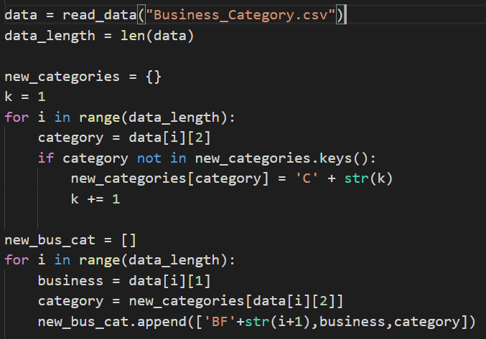
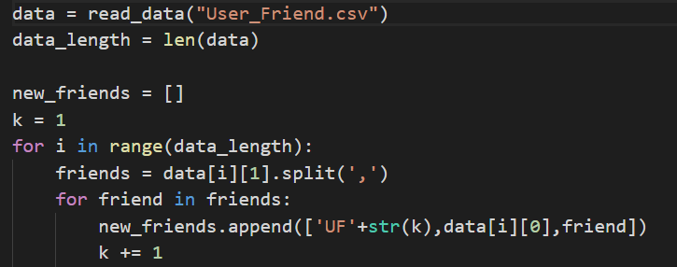
Normalization Process
Put one element in a cell
Created New primary key
Save into new CSV file
Imported back to ACCESS
Notes:
Therefore, we used python and put those elements in a newly created table.

Slide 15
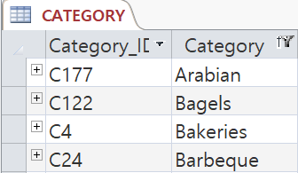
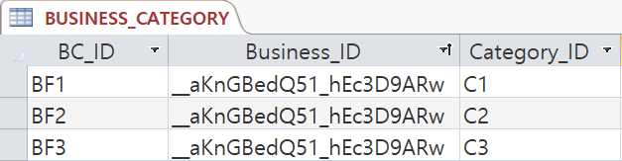
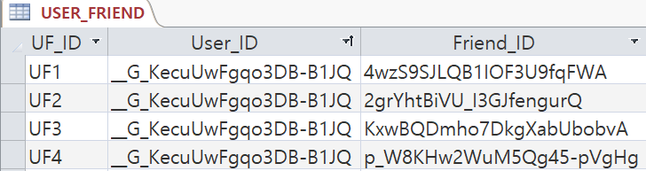
Normalization Process
Created new tables
CATEGORY with a primary key, Category_ID
BUSIENSS_CATEGORY (Intersection Table)
USER_FRIEND with a primary key, UF_ID
Notes:
Now, the attribute, categories in BUSINESS table is located in a new table, CATEGORY
And intersection table, BUSINESS_CATEGORY were built in order to link BUSINESS and CATEGORY.
For friends, we made USER_FRIEND table and put each element in a cell.

Slide 16
Adding Tables & Attribute
In order to solve the problem we brought up, we added new information
STATE_GDP and ZIP_INCOME table
Downloaded csv files from www.bea.gov
Polarity of text in REVIEW
Used python to do the sentiment analysis
Inserted new columns in REVIEW table
Notes:
In order to supplement the star systems, we needed more information than What we obtained.
We considered income and polarity of review text as important factors.
We downloaded GDP by state and INCOME by zip CSV file and imported them to ACCESS.
Also, we did sentiment analysis of review text to see if they are positive or negative.

Slide 17
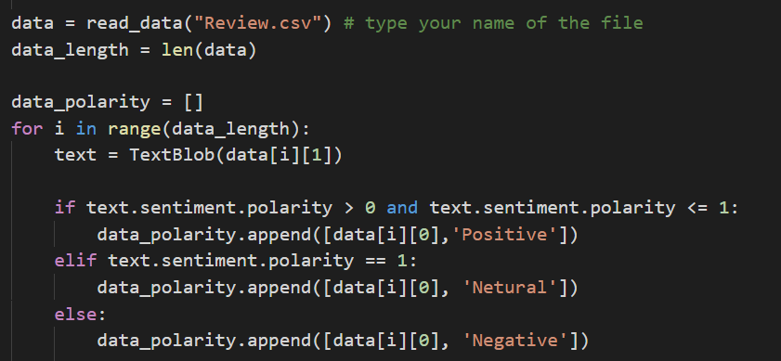
Creating Polarity Attribute for REVIEW
Notes:
Here is the code we used for sentiment analysis of the text.
We again saved the result to csv file and put it in the access.
This time, we replace the old REVIEW table to this new one.

Slide 18
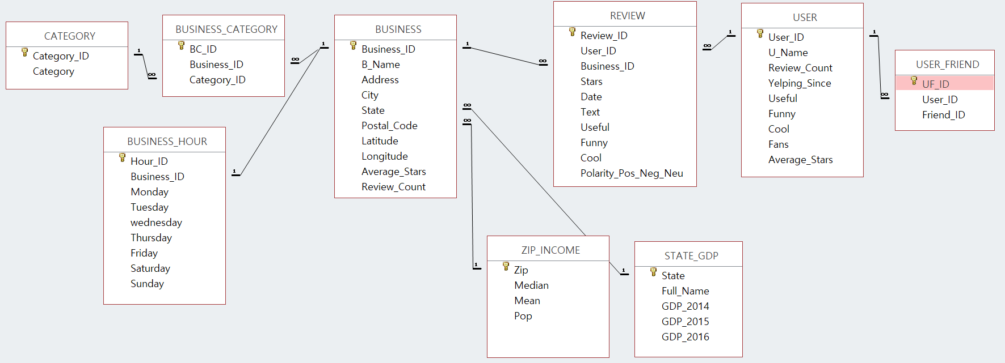
Relationship in ACCESS
Notes:
Here is the completed relationship we made in access.

Slide 19
Business Rules
If BUSINESS or USER row is deleted, a row of REVIEW that is connected to those tables is also deleted.
Any businesses that are not located in state that is in STATE_GDP or in postal code that is in ZIP_INCOME cannot be inserted on BUSINESS table.
If CATEGORY row is to be deleted and that row is connected to any BUSINESS_CATEGORY row, the CATEGORY row deletion will not be allowed.
Notes:
We made three business rules that are required to be followed in the relationship.
If I briefly explain what they are,
The first one indicates that any row of review that is not connected to both BUSINESS and USER cannot exist.
The second one says that every business has to link to STATE_GDP table and ZIP_INCOME table.
The last one disallows the row of CATEGORY to be erased if it is connected to BUSINESS_CATEGORY table.

Slide 20
Example of Query
SELECT BU.City, BU.Business_ID, [B_Name], Review_Count, Avg_Star_Business, Avg_Star_City
FROM (SELECT B.City, RS.Business_ID, [B_Name], Review_Count, Avg_Star_Business
FROM BUSINESS AS B,
(SELECT Business_ID, count(Business_ID) AS Review_Count,
Round(Sum(Stars)/count(Business_ID), 1) AS Avg_Star_Business
FROM REVIEW GROUP BY Business_ID) AS RS
WHERE RS.Business_ID = B.Business_ID) AS BU
RIGHT OUTER JOIN
(SELECT City, ROUND(AVG(Stars),1) AS AVG_Star_City
FROM REVIEW AS R, BUSINESS AS B
WHERE R.Business_ID = B.Business_ID GROUP BY City) AS CI
ON BU.City = CI.City;
Notes:
Here is one of the examples of Queries we made.
It shows three main things:
The number of review count of each business,
the average star of each business and
average star of whole businesses in one city.
So, the customers can understand how high the business is rated in a specific city.

Slide 21
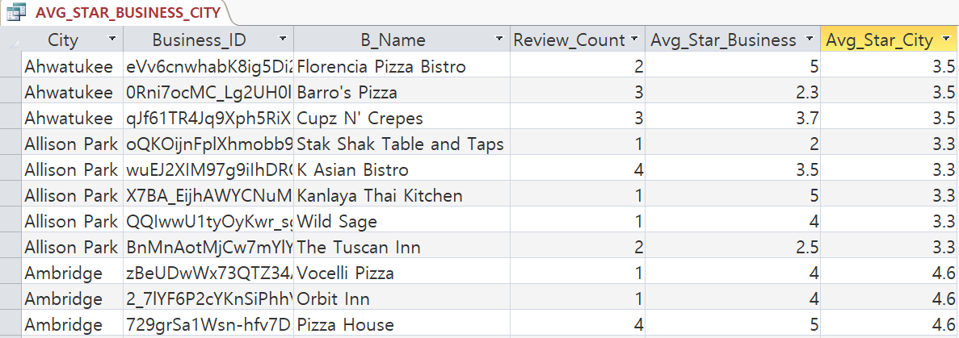
Result of Query
Notes:
This is how it looks like when the query is executed.

Slide 22
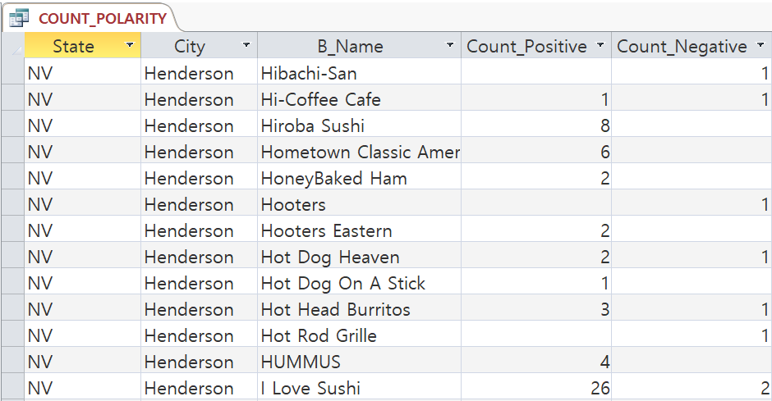
Example 2

Slide 23
Demo

Slide 24
Question? Comments?

